Slide 1
TITLE = {FBI’s missing crime data:
[What does it mean for New York?] }
PRESENTERS = {Travis Zhou, Manan Brahmbhatt,
Dolores Chang, Jennifer Jiang}
Date= {May 9, 2023}

Slide 2

Context
In 2021, the FBI retired its nearly century-old national crime data collection program, the Summary Reporting System used by the Uniform Crime Reporting (UCR) program. The agency switched to a new system, the National Incident-Based Reporting System (NIBRS), which gathers more specific information on each incident.
Nearly 40% of law enforcement agencies around the country did not submit any data to the new system in 2021, leaving a huge gap in national crime statistics.

Slide 3
Why NIBRS?
Under the old Summary Reporting System, agencies reported crimes by types of offenses, and the FBI published annual reports on nationwide trends.
The old data collection system did not collect
The crime’s time of day
Age and race of victims
Some crime types i.e. cyberstalking
Less serious offenses in one incident
-SRS: counts limited data for 10 offenses and 20 additional crimes for which only arrests are reported
-NIBRS: collects data for 52 offenses, plus 10 additional offenses for which only arrests are reported.

Slide 4
Timeline
1930
Congress authorized the FBI to collect, compile, and distribute crime records, with its first report due in September
1988
the FBI launched a new data collection system, designed to track more crimes and in more detail, that ran in parallel with the old system
2015
the FBI announced that it would retired the old data collection system in 2021
2021
2022
the FBI retired the old system
the FBI published its 2021 national crime data estimates based on statistics submitted through the NIBRS system

Slide 5
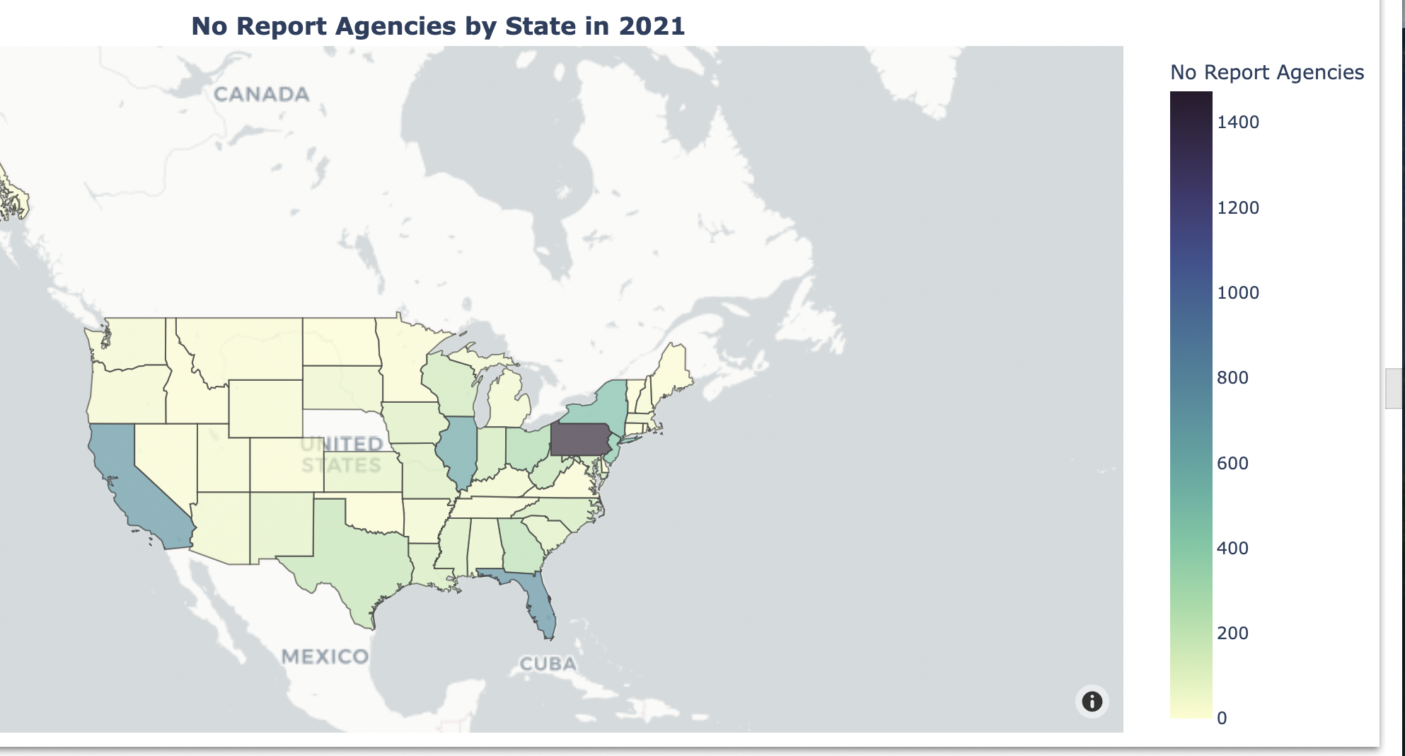
Current Landscape
Nearly 40% of local new enforcement agencies did not successfully report data to the federal government, and nearly 4,000 agencies reported partial data
source:https://colab.research.google.com/drive/11xdCq2SiAR9CXCxZENJwQiV94BcvBznC#scrollTo=KYfb7oYdwe6w

Slide 6
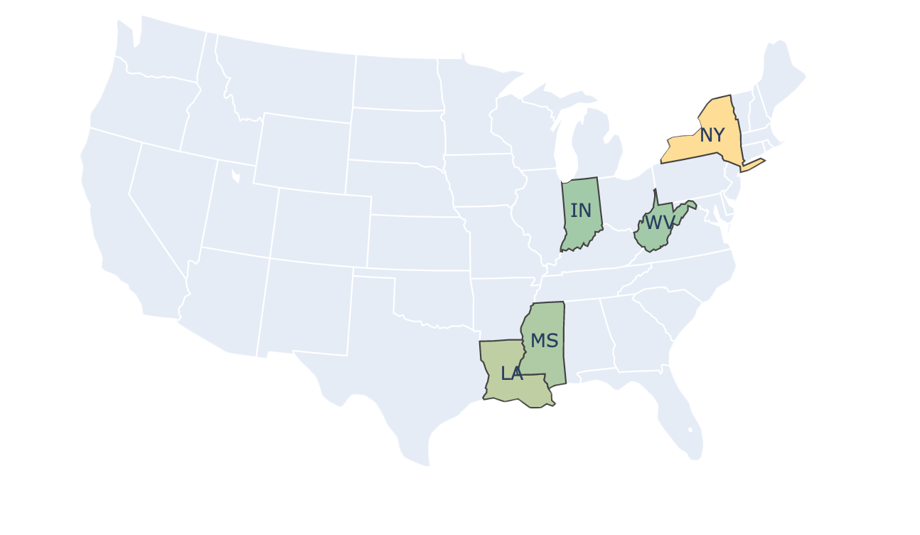
Our initial pitch
New York
Louisiana
Mississippi
Indiana
West Virginia

Slide 7

And we switched

Slide 8
Datasets we have
index crime data (from 1990–2021). While FBI data only contains data from NIBRS, the Division of Criminal Justice Service (DCJS) still accepts data submitted through the old system.
the 2021 and 2022 New York agency participation data from the FBI (how many months a specific agency reported data to the NIBRS in 2021 and 2022)
NIBRS estimations from the FBI (contain the estimation bias and errors calculated by FBI)
Notes:
So let’s collect the data from the third dataset to see how these states perform in 2021.

Slide 9
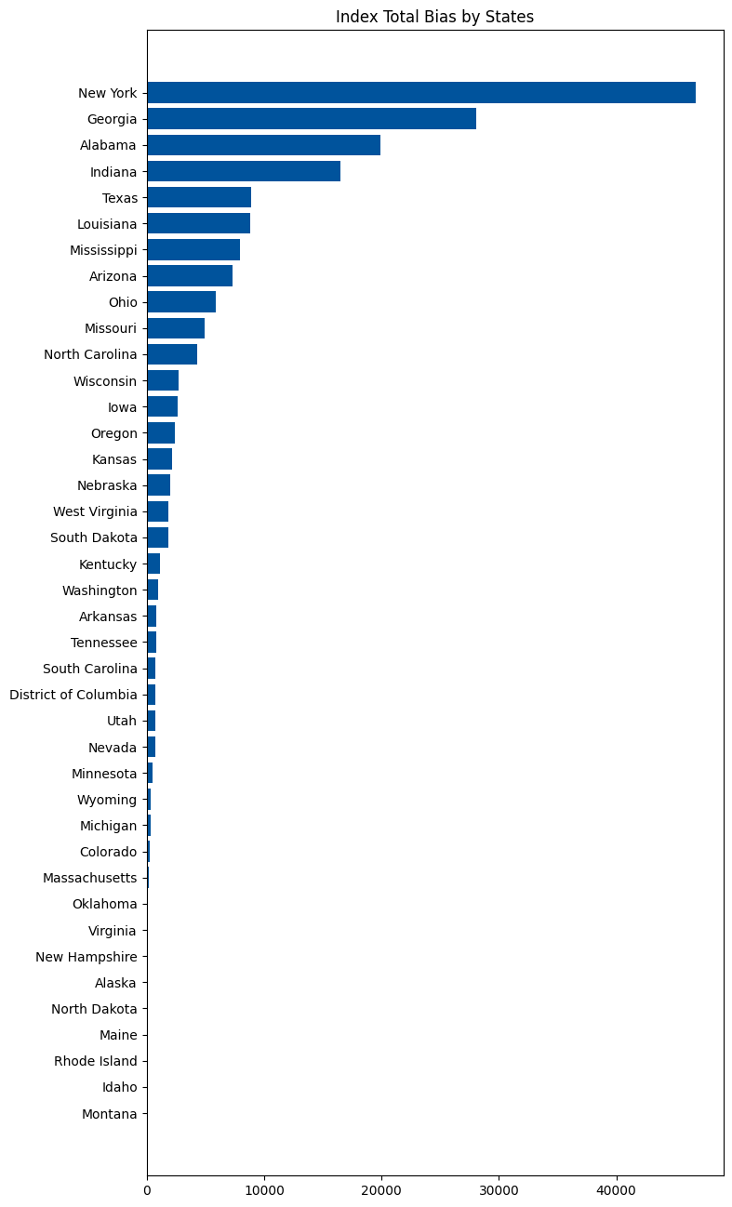
How these states perform
in 2021?
#Bias: Calculated by NIBRS
#Removed some states from the plot because the NIBRS system did not provide estimation or bias for them
#NYS performed the worst among these states
Notes:
This barplot shows the estimated bias of index crime total by states, and it is provided by the NIBRS system.
This plot shows that the estimation bias of most states is relatively high, and New York state performed the worst among these states.
Since we have the actual crime data from DCJS, we can also calculate the bias by ourselves for New York State. When we calculate the difference between DCJS real data and NIBRS estimation, we obtained the following plot.

Slide 10
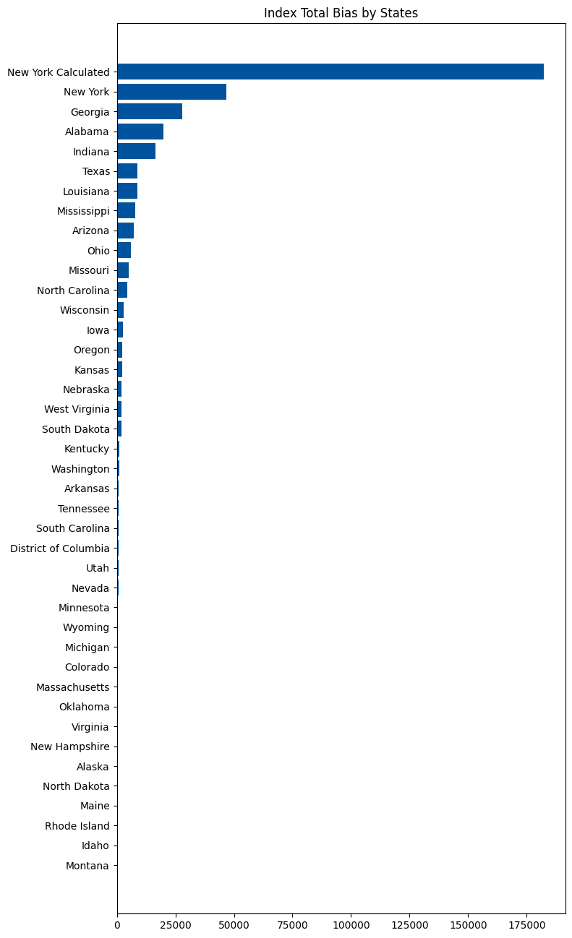
How these states perform
in 2021?
#Bias = Actual data - estimation
#Not even on the same order of magnitude as the NIBRS bias!!
#The estimation bias caused by NIBRS is even more severe than what we currently observe!
Notes:
And NYS had a really bad performance. Has it always been like this? Let’s focus on NYS to see how it performed over time.

Slide 11
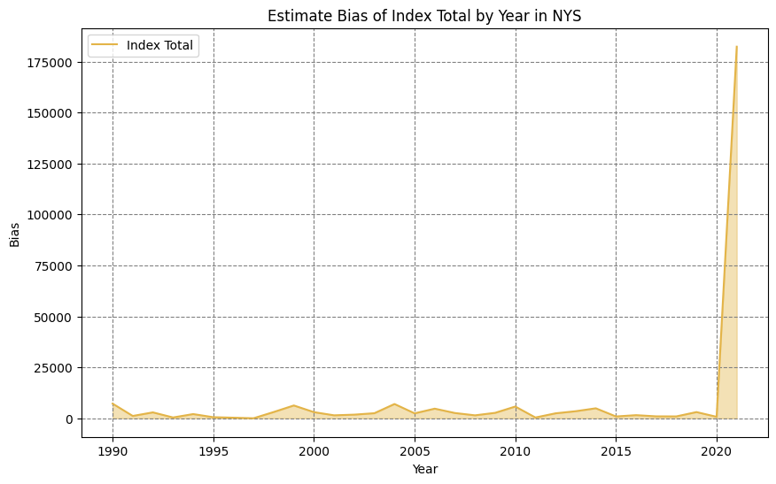
How did New York state agencies perform over time?
#SRS estimation VS NIBRS estimation
#The huge gap between 2020 and 2021 can only tell us how unreliable the NIBRS system is!
Notes:
Next, we will take a closer look at how bad the estimation really is.

Slide 12
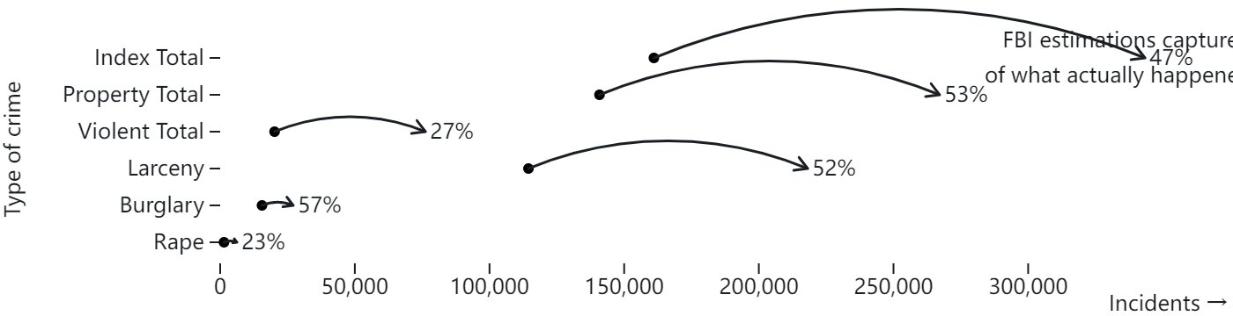
Analyze the data
#Most of the estimations do not even explain half of the actual data!

Slide 13
Why is the estimation so bad?
Even experts cannot provide a concrete answer to this question because the estimation procedure provided by NIBRS only has vague descriptions. However, we can examine the specific situations of some factors mentioned in this procedure.
Partial reporting agencies
Non-reporting agencies
Population coverage rate

Slide 14
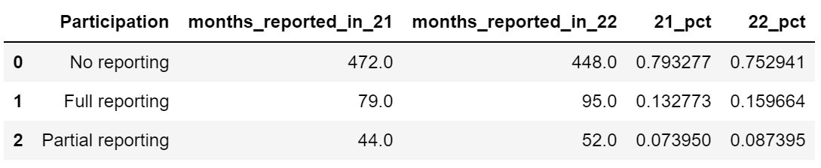
Interactive map
How did different counties and agencies do in reporting the data to NIBRS in 2021?
https://colab.research.google.com/drive/1MRhsxBzq2W77yfGhtE1rzX-0rJUmFiQG#scrollTo=pjCNgp2avj7m
#The estimation can never be good given these lack of information!

Slide 15



Sources
Jeff Asher is a data analyst with expertise in evaluating criminal justice data. He once worked as an analyst for the Central Intelligence Agency, the U.S. Department of Defense, and as an analyst with the New Orleans Police Department.
Jillian Snider is a former NYPD police officer and current professor in the Criminal Justice department
at City University of New York. She wrote articles about the lack of NIBRS reporting
compliance.
Jacob Kaplan, a Professional Specialist at the Princeton School of Public and International Affairs where he does research on policing. He created the Crime Data Tool to make it easy for people to look at crime.

Slide 16
Reporting questions
Why did the transition from the SRS to the NIBRS take so long?
“The conversion is to collect a lot more information, which means the agencies have to buy an entirely new data management system. And then they have to retrain everyone who's inputting data. Agencies are sometimes reluctant to do that, especially if the state isn't requiring them to do that. So when the FBI said in 2015, that 2021 was the last year agencies would report to the old system, a lot of agencies just didn't believe them. They probably thought that the FBI would give them an extension.”
Jacob Kaplan said.
“For New Orleans, it's a technical problem, they don't have the records management system, and it's not clear when they're going to get it. So it's not something that sort of has an easy solution either.”
Jeff Asher said.

Slide 17
Reporting questions
Why did the FBI publish estimations for rape, burglary, larceny, but did not estimate Murder
Robbery, Aggravated Assault, and Motor Vehicle Theft?
“The FBI says in one of their reports about their estimation procedure that they have a process to determine when the estimate is too wide. In the case of New York State, they shouldn't be reporting anything just because they're missing so many other agencies.
And it's weird that they're reporting some crimes, not others. My guess is that murder and robbery are relatively rare, at least compared to other crimes, that might be their concern that they're too rare to estimate properly. And therefore, they're not reporting the rest of it.”
Jacob Kaplan said.

Slide 18
Reporting questions
How much should we trust the FBI’s report in understanding the national trend of crime, if we have a fairly good participation rate?
“The FBI does not estimate local data. They just do state data. But I feel like local news understands the circumstances better of what's going on in their own town. And they could talk to like the police chief and see do these numbers make sense. But estimates aren't really that important anyways, just because crime policy is so local. Just because decisions on policing, mental health services, or poverty services, even like state law, is less important than local decisions. Because how you enforce it, it's really depend on the local level of the police chief or the district attorney’s decisions.”
Kaplan said.

Slide 19
Reporting questions
Given that the current landscape of NIBRS crime data collection is incomplete, should there be concerns regarding the use of this data?
“ I work primarily, I try and implement or give suggestions or policy recommendations, based off the data that we have, you look at the data, you analyze it, you try and come up with a solution. So if you have incomplete data, it's really hard to be able to come up with a plausible and practical solution, because you're working with, like I said, incomplete information.”
“it just really depends on where you're looking. But I would say as it stands now, I don't feel comfortable me personally, using last year's FBIs report to make any conclusions.”
Jillian Snider said
“But when the 2020 crime data came out, or I guess the 2021, crime data came out, like pretty much every news agency reported on the numbers. And they reported as if there was a true number, and then later on, in the article, they're all like, these are estimates and like, experts say you shouldn't trust them. But I think for most people, if you're gonna read like the headline in the first paragraph, you're like this is the true number of crime in my state or in the country. So I think people are going to be making decisions based on that, even though it's like not very well done”
Kaplan said.

Slide 20
Reporting questions
How much do we know about the FBI’s methodology in making estimations? Why is there so little public information about their estimation procedure?
“It's not super specific. So they say if an agency is missing, they will replace the data with a comparable agency, though they don't specify super clearly what a comparable agency means. And as far as I know, they also haven't released anything about their steps to verify that their estimation is correct. And from what we've seen in New York, the estimation is at least in some cases, very not correct.”
Kaplan said.

Slide 21
Independent Estimation
FBI’s estimation seemed to be very inaccurate. Therefore, we tried to create our own estimations to see if there was a naive approach that was better than the FBI.
Method:
Input crime data for New York State by county since 1990
Fit an ARIMA model (auto.arima() in Python) on each county for each type of crime on data from 1990-2019
Predict values for 2020 and 2021
Sum predictions for 2021 across each county to estimate New York State total

Slide 22
Results
 | New York State Total | FBI Estimate | Independent Estimate | Percent Difference - FBI | Percent Difference - Independent
Violent Crime Total | 76229 | 20202.815789 | 93905.044274 | 73.4972% | 23.1881%
Property Crime Total | 267128 | 140832.311404 | 350368.382144 | 47.2791% | 31.1612%
Index Crime Total | 343357 | 161035.127193 | 472005.590169 | 53.0998% | 37.4679%
It seems that our independent estimate seems to perform better than FBI’s estimate. Why?

Slide 23
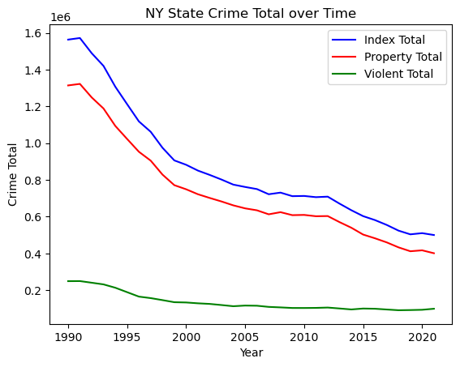
Potential Reasons and Future Accuracy
It is possible that FBI doesn’t use historical crime data
COVID effect - unprecedented times in 2020 and 2021 led to greater uncertainty
Future Steps:
Incorporate other factors that play a role in crime
(i.e. population)
Find out how to account for COVID as an effect for
2020 and 2021
Go to FBI with these results and potentially question
their methodology

Slide 24
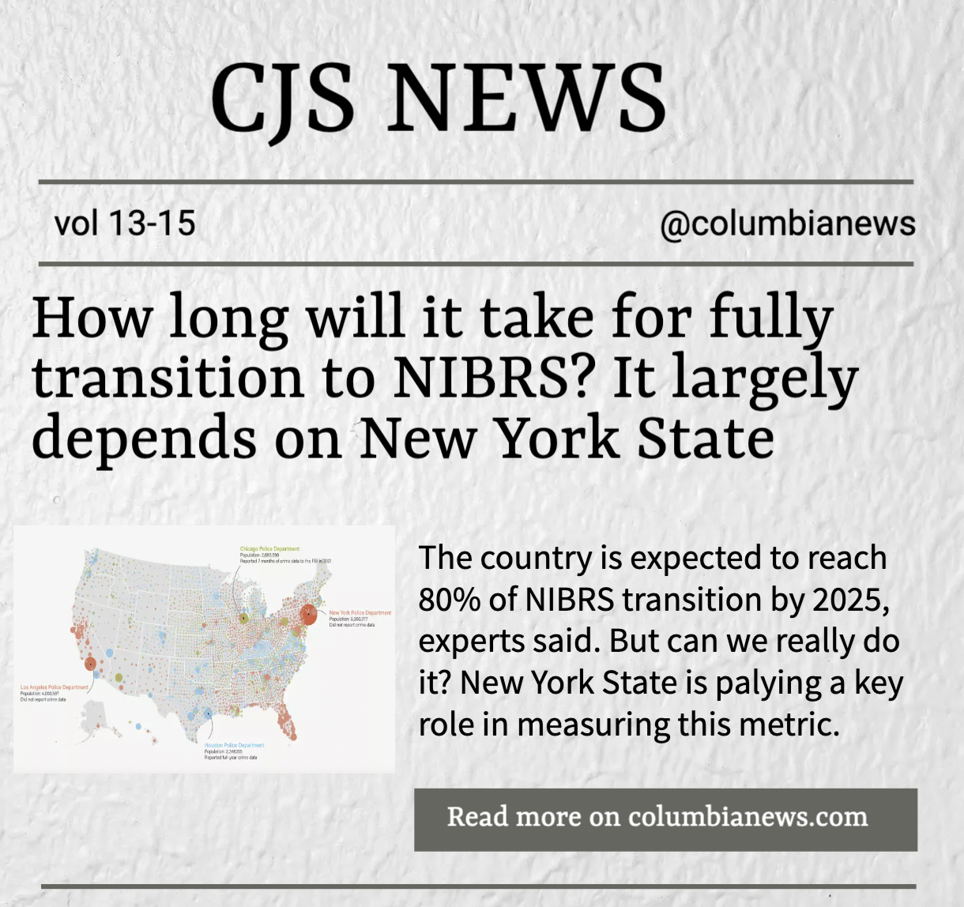
Reporting plan
Story angle
After two years, new york state is still one of the biggest holes in the fbi crime data, misleading media and the public in understanding national crime trend.
People Sources
-state agency, New York State Division of Criminal Justice Service, Office of Criminal Justice Records
Data Sources
-including our own independent measure of New York City’s crime data compared to FBI’s estimation.
Notes:
So based on our research and conversations we had with experts, we landed on our own reporting plan to talk about the NIBRS.
For the whole story, we would like to dive into the reason behind this really low participation of data delivery and the bias of those data, such as lack of funding, and the time needed for training employees to apply the new system. In addition to experts that we already build our connection with, we plan to reach out people from state agency in new york state.

Slide 25
Future Steps
A website that allows audiences, agencies, and journalists to read,understand, publish, and write data-driven content that are both statistically accurate and journalistic meaningful.
There is a threshold for the general public to understand data in a journalistic way
Journalist are easily to make misinterpretation or depict those data in a way that cater to their stories most while ignoring the statistical meaning of numbers
“Eight ways the media will mess up reporting on 2021 crime data”
There is a lack of information exchange between agencies across the various levels of the country.
Hence,
We hope there could be a platform organized by a group of journalists and statisticians that aim for informing the public about the country’s crime data with simple and accurate interpretations, as well as allowing agencies to see how they are performing in the industry.
Notes:
Since the whole thing we are talking about today is still going, we will have the official data about 2022 crime data released later this year, so we also have work that we want to convey for the future works. The main content we would like to delivery in the future is a website, which is also a platform for people to explore the complicated data world.
The reason we want to do that is because currently we have so much data documents public to people, but not really accessible to people because it requires certain data sensitiveness to understand them. The most frequent questions me and Dolores asked during the semester is asking Travis, given this data, can we draw this conclusion or not. So we really hope that there could be a tool that can translate those statistics findings into the journalistic expression.

Slide 26
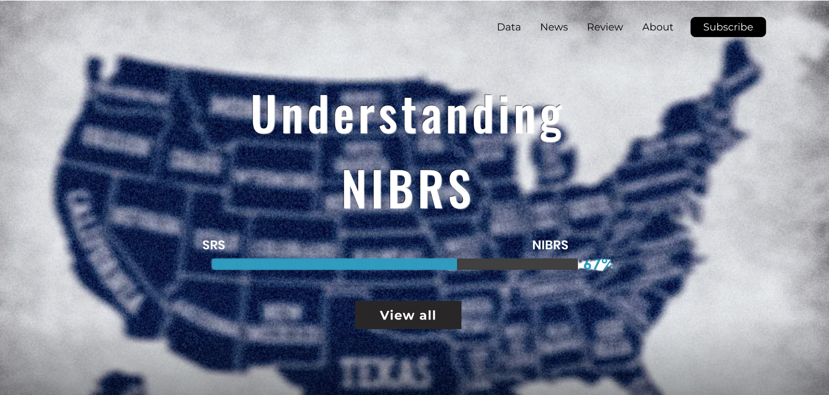
Updated, consistent datasets, with systematic explanation of professional and technical terms and reviews given by experts
Original articles with independent estimations and exclusive interviews
Agency’s performance by comparing to agencies in other regions with similar demographics
Review about current news articles that quote NIBRS data
Notes:
In the website, we will start with a progress bar that depicting the current progress of the country’s transition to NIBRS. Then, users can click view all to see the performance of the agency they want to search about. Because this overall transitional rate could not represent something since New York state only has less than 16% of its data transitioned to NIBRS.
Other functions..

Slide 27
Sources
https://github.com/HiddenS1/Newsroom.git
Notebook
https://drive.google.com/drive/folders/1P78LIDRNcZdwICotEhAu0auMOa8u-vtA
Independent Estimation
https://drive.google.com/drive/folders/1Bxb9o85UZltsEL098oZyH68DXnbWj2rc
Visualization
https://drive.google.com/drive/folders/1DoiTZu369HrFhLyLMy31uG7Qexv3i-0O
Interviews
https://drive.google.com/drive/folders/14OzgFWBdmZYPz_3SQlHucH7xSPfrcEuk

